Slide 1



Fire Brigade Dashboard London
View in Power BI
Last data refresh:
8/14/2021 6:41:55 AM UTC
Downloaded at:
8/14/2021 6:51:33 AM UTC

Slide 2
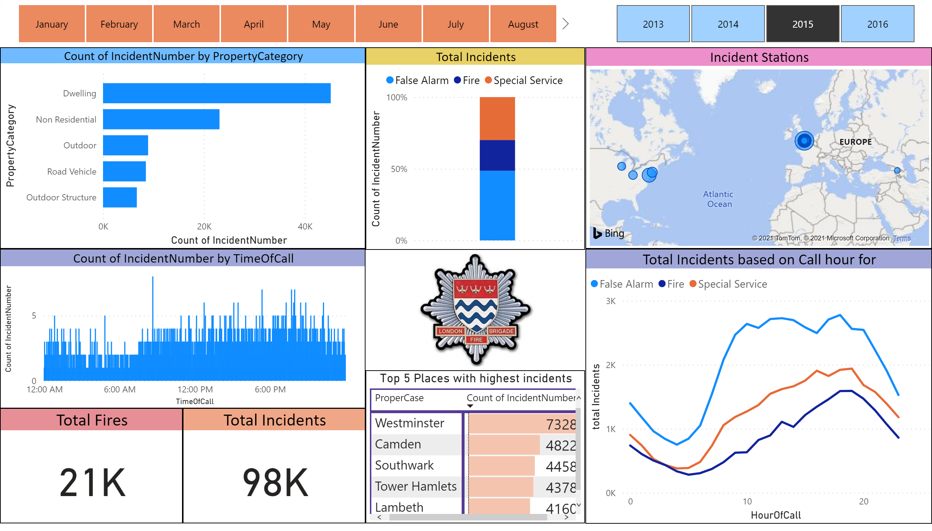
Page 1
Notes:
Total Incidents
No alt text provided.
slicer
No alt text provided.
Total Fires
No alt text provided.
Total Incidents based on Call hour for
No alt text provided.
Incident Stations
No alt text provided.
lineStackedColumnComboChart
No alt text provided.
Total Incidents
No alt text provided.
clusteredBarChart
No alt text provided.
Top 5 Places with highest incidents
No alt text provided.
slicer
No alt text provided.
image
No alt text provided.

